Slide 1
“SPACE INVADER”
Terminal Project
Muhammad Ali Zafar (SP21-BAI-016)

Slide 2
Introduction
Space Invaders is a fixed shooter in which the player moves a laser cannon horizontally across the bottom of the screen and fires at aliens overhead. The aliens begin as five rows of eleven that move left and right as a group, shifting downward each time they reach a screen edge. The goal is to eliminate all of the aliens by shooting them. While the player has three lives, the game ends immediately if the invaders reach the bottom of the screen. The aliens attempt to destroy the player's cannon by firing projectiles. The laser cannon is partially protected by stationary defense bunkers which are gradually destroyed from the top by the aliens and, if the player fires when beneath one, the bottom.
As aliens are defeated, their movement and the game's music both speed up. Defeating all the aliens brings another wave which starts lower, a loop which can continue endlessly. A special "mystery ship" will occasionally move across the top of the screen and award bonus points if destroyed.

Slide 3
Pygame
As Pygame and the SDL library are portable across different platforms and devices, they both need to define and work with abstractions for various hardware realities. Understanding those concepts and abstractions will help you design and develop your own games.
Initialization and Modules
Displays and Surfaces
Image and Rects
Pygame libraries also helps in display settings, adding images and audio it makes things more reliable when we build interface for our game
In this game we are using Pygame libraries.
Import Pygame

Slide 4
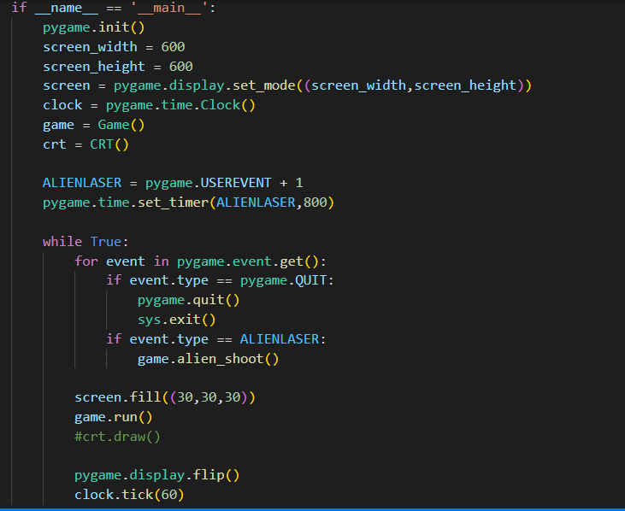
Main
This part of code displays the black empty window.
In this we are setting the width and height of window. And calling some functions.
We are also using timer.
These all things are managed by Pygame libraries.

Slide 5
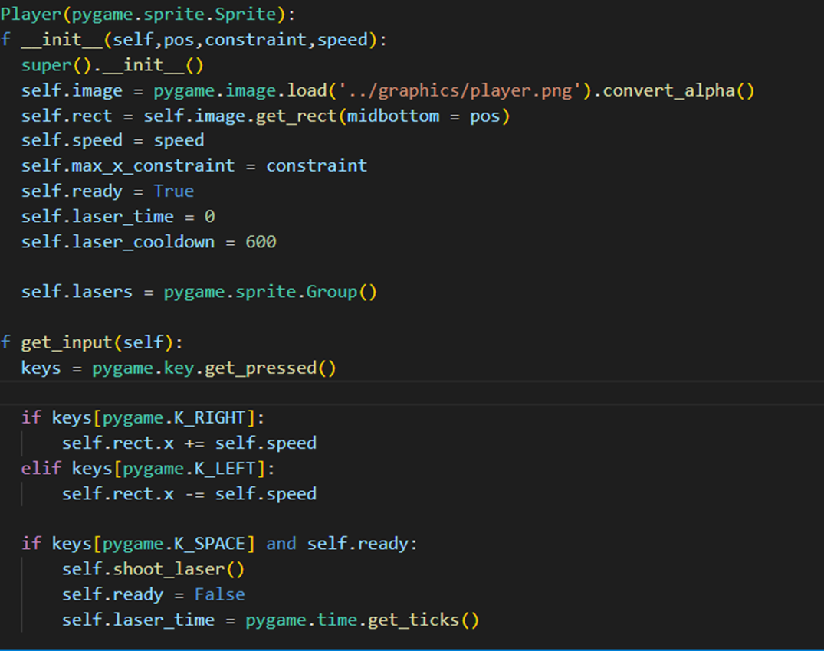
Player
In player class, first we imported image by providing path using Pygame library
Then we used if\else statements to move player left and right
When user press “space” key the laser shoots.

Slide 6
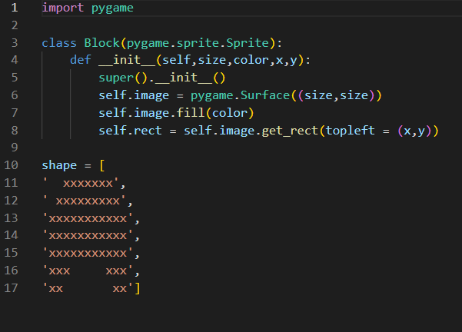
Obstacles
This block class provides the shape of obstacles.
As obstacles are not rigid so for this, we use enumerate it divide these obstacles in small blocks
Set color and position accordingly

Slide 7
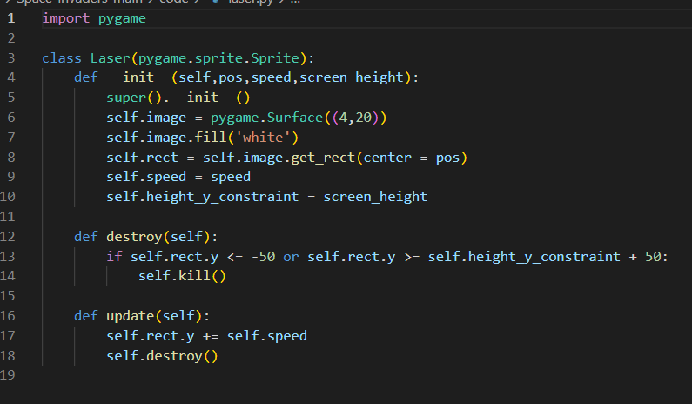
Laser
In laser class , we are setting speed, height and color of laser
We used a destroy function and screen height because we want to execute laser in y axis

Slide 8
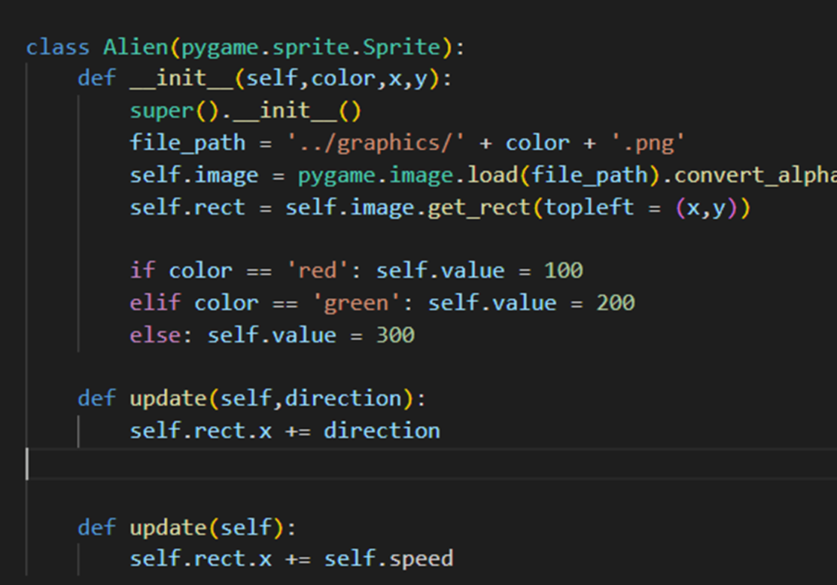
Alien
In Alien class , we are inserting an image
Using different colors to represent different type of alien’s
Directions and location of aliens are discussed in Main

Slide 9
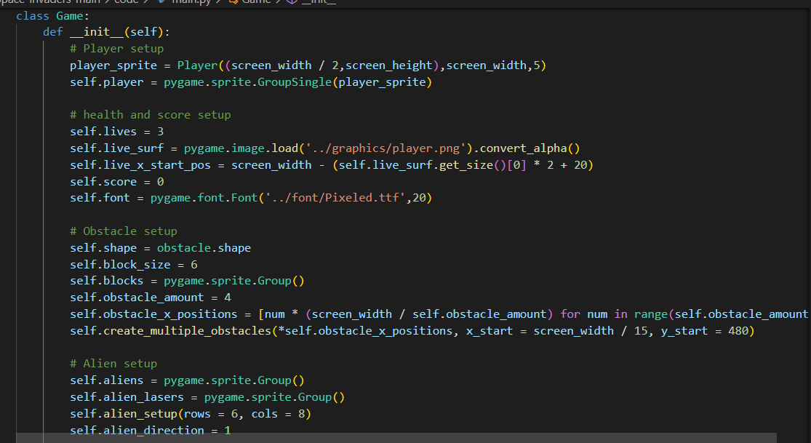
Player, Aliens, Obstacle, health and score setup
In this Game class player, obstacles and aliens' locations are defined
For health and scores we set health 3 and represent health by inserting image at top right of window
5 rows and 8 columns are used in setting aliens

Slide 10
Functions
cooldown(self)
The purpose of this function is to have a cool down counter which means that after a ship has shot a laser, the next laser can’t be shot immediately. There should be a time gap of for example half of a second.
Collision check(self)
The purpose of this function is to check whether the laser of player or alien hit each other . This has been implemented by checking that the pixels of objects overlap or not.

Slide 11
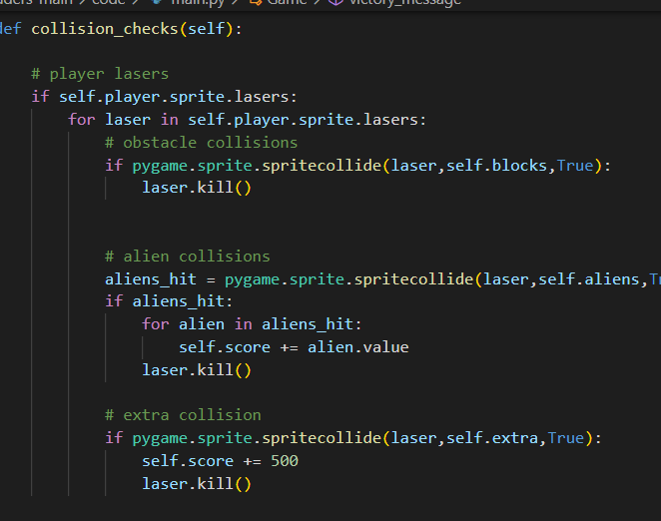
Collision Checks
When player intersects aliens, player loses.
When alien laser intersects player , player loses
When aliens hit the bottom of screen, player loses
When aliens intersects player bullet, ship sprite is killed

Slide 12
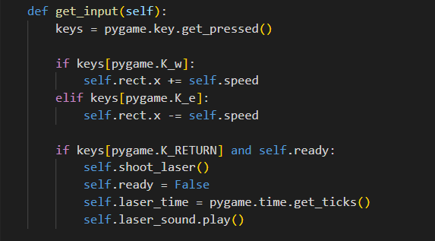
Input Challenges
We can customize our input by changing this piece of code we used
‘w’ instead of ‘RIGHT’ and
‘e’ instead of ‘LEFT’ and
‘ENTER’(RETURN) instead of ‘SPACE’

Slide 13
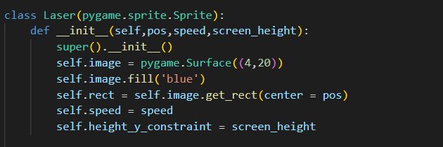
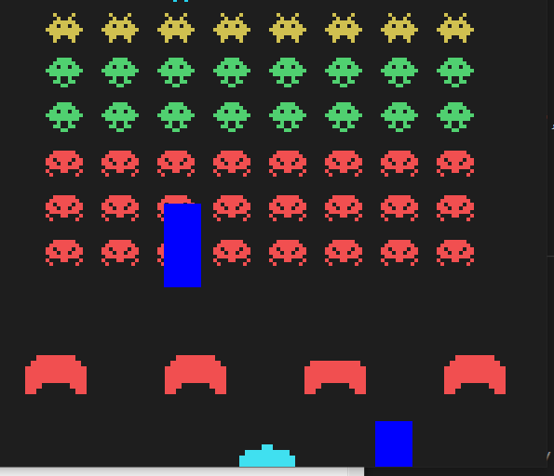
We can resize our laser easily and change color of lasers

Slide 14
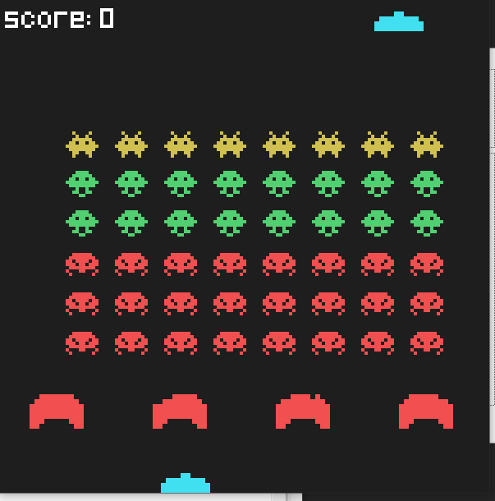
Space Invader

